Slide 1
SMART WORK Reading Activity
Firm Due Date: 11:59 PM Tuesday (1 September)
~75 students not signed up for Smart Work
Use 2-week trial access if necessary to get it done
Get it done before the deadline
Plenty of guidance on BlackBoard on how to register for an account

Slide 2

Geology 101 Lab 1
Tectonic Plate Boundaries

Slide 3
What is happening?
Please discuss with at least one of your peers your current understanding of the following:
What are plate boundaries?
What makes the boundaries different?
How are they determined?
How do scientists decide?

Slide 4
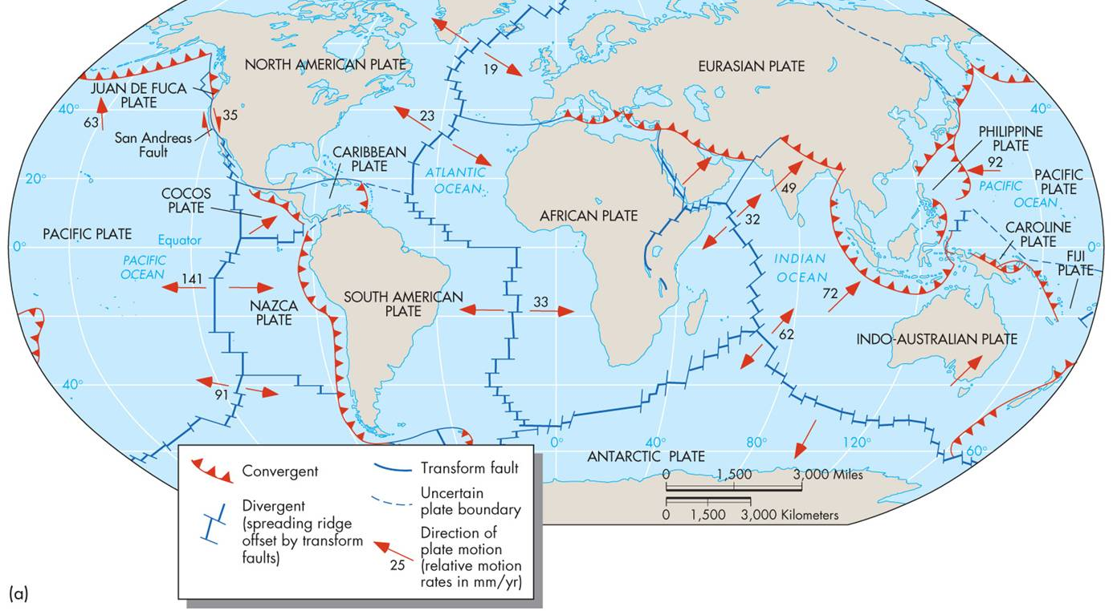
Global Plate Boundaries
How and Why are they different?

Slide 5
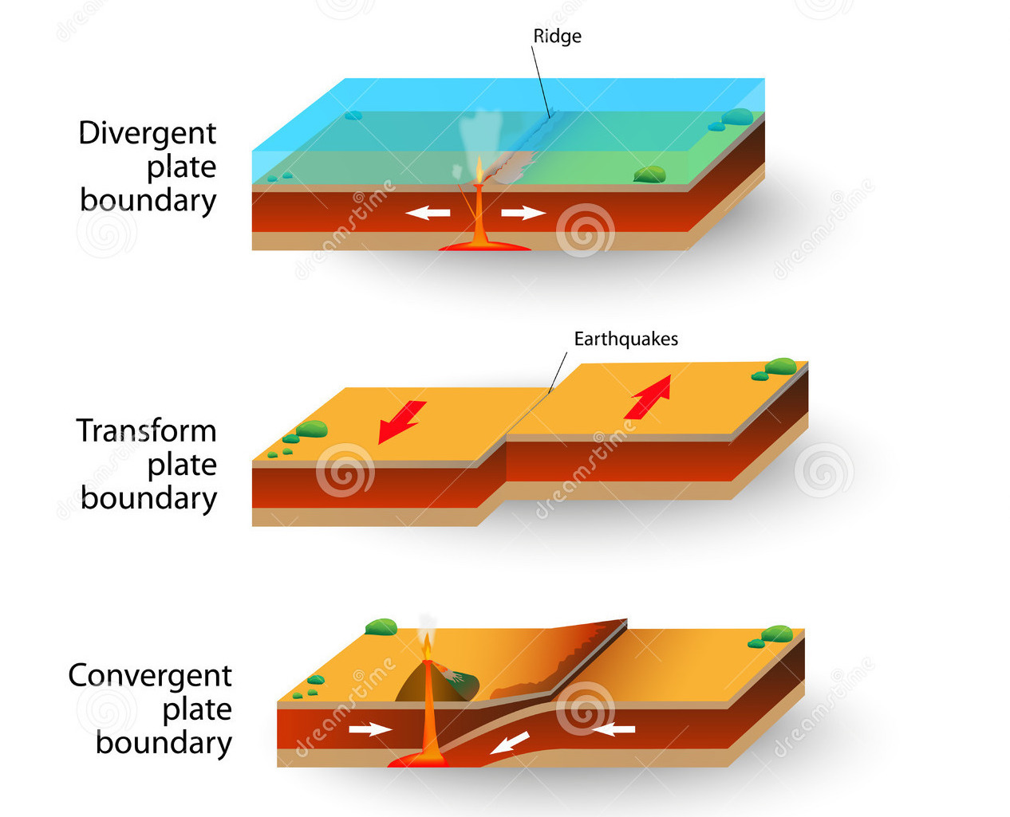
Three Boundary Types
Divergent
Transform
Convergent

Slide 6
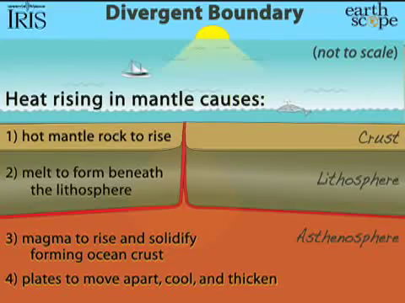

Slide 7
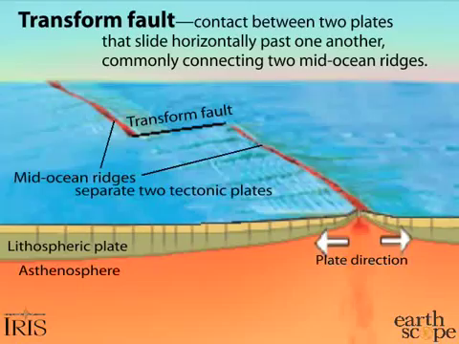

Slide 8
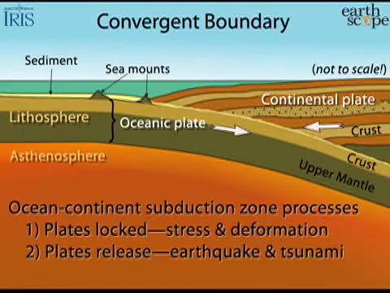

Slide 9
How are the boundaries determined?
Scientists use;
Seismic (earthquake), Volcanic, Topographic (land elevation), and Geochronology (seafloor age) data to decipher plate motion and the different boundary types.
We will be deciphering plate boundaries using the same data today…

Slide 10
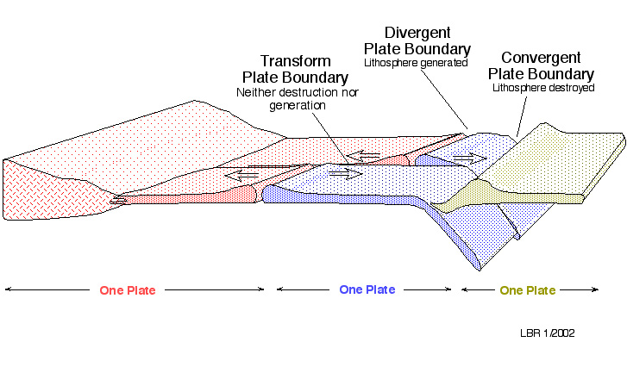
How can we categorize plate boundaries?
Earthquake depth, size, and abundance
Volcanic distribution and abundance
Topographic highs and lows
Seafloor age
Symmetry

Slide 11
Lab Instructions
You will be put into a specialty group (A-D) and later a plate boundary group (1-7)
Each specialty group will observe patterns, draw plate boundaries, and label each boundary with a key (the key can be written on the back of the map)
See your lab sheet for further detail

Slide 12
Lab Instructions
After completing your first map with your specialty group, you will be divided into your plate groups
Each plate group will observe and discuss patterns found from each specialty
Draw and label connections on your second map (observations can be written on the back of the map)
See your lab sheet for further detail

Slide 13
Lab Instructions
Each plate group will present their findings to the class in a 2-3 minute presentation
Specialty Group | Plate Group
A - Seismology | 1 - No. American & Caribbean
B - Volcanology | 2 - Pacific
C - Geography | 3 - African & Arabian
D - Geochronology | 4 - So. American & Nazca
 | 5 - Eurasian
 | 6 - Australian & Indian
 | 7 - Antarctic

Slide 14
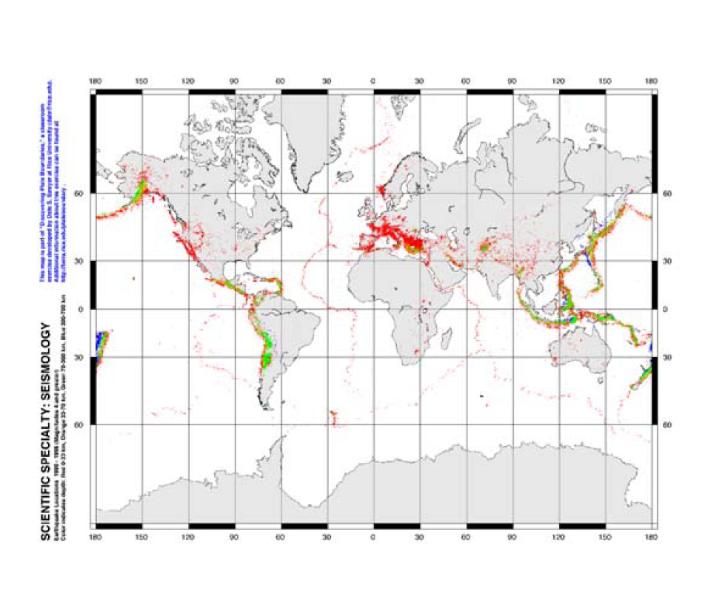

Slide 15
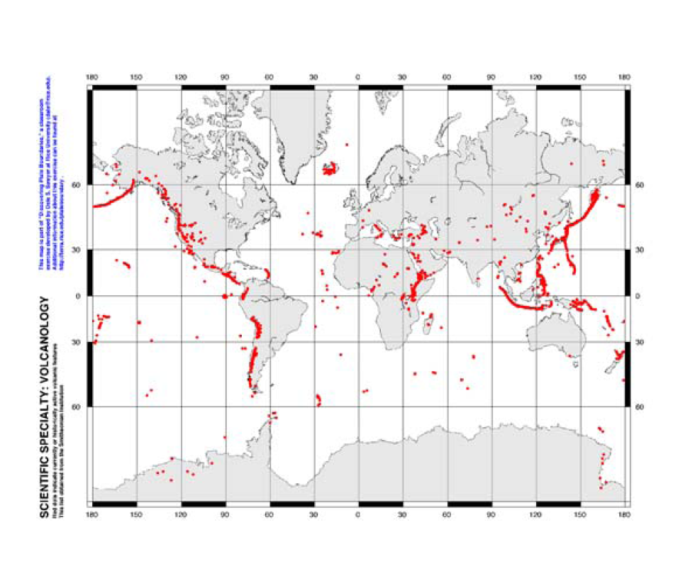

Slide 16
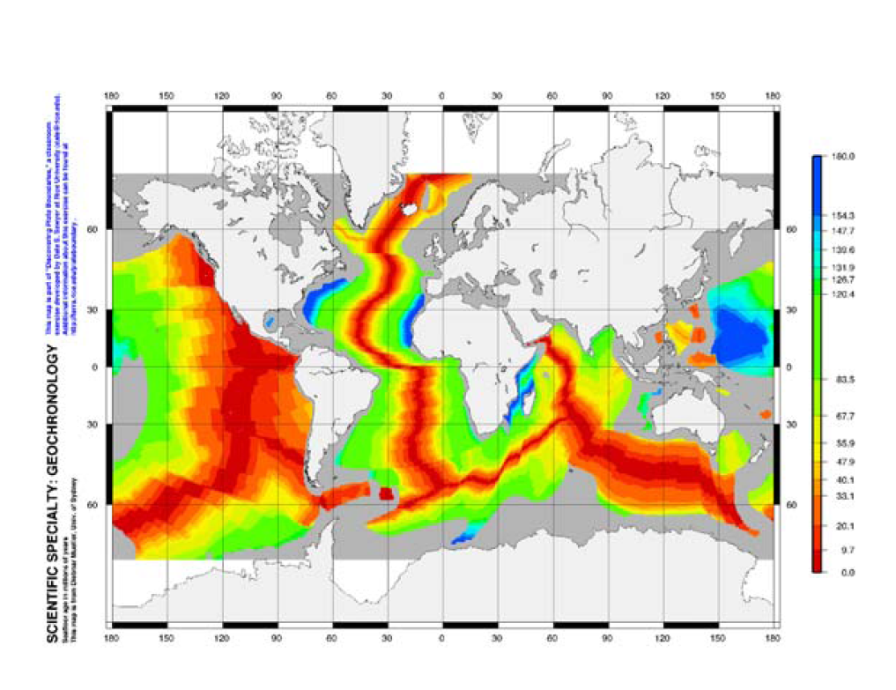

Slide 17
